Slide 1
Wineinformatics: Regional Prediction Using KNN and Similarity Indices
Jonathan Onyumbe, Hunter Moore, Alex Riley, Nnaemeka “Newman” Okereafor
CSCI 5370
University of Central Arkansas

Slide 2
Introduction
Origin and Wine making process : Napa and Bordeaux (Old and New World)
Wineinformatics
KNN
Distance metrics

Slide 3
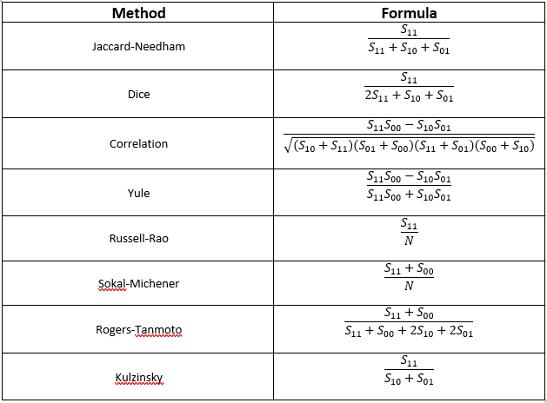
Methodology
296 Bordeaux samples, 347 Napa samples. 446 attributes.
[' Cornerstone Cabernet Sauvignon Howell Mountain Cornerstone Vineyard 287',0,0,0,0,0,0,0,0,0,0,0,1,0,0,0,0,0,0,0, … ,’Napa’]
[' Château Lafleur Pomerol 20',1,0,0,0,0,0,0,0,0,0,0,0,0,0,0,0,0,1,0,0,...,’Bordeaux’]
Four wines were removed from the Napa dataset due to having zero attributes present out of the 446.
S₁₁: Intersections: Attribute present in both wines
S₁₀ , S₀₁: Attribute present in only one of the wines
S₀₀: Attribute not present in either wine

Slide 4
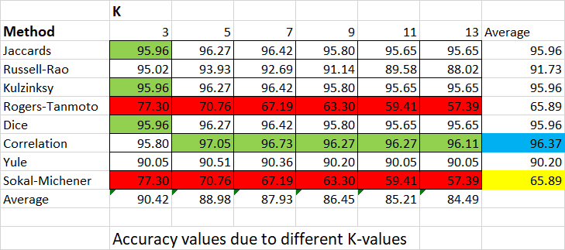
Results

Slide 5
Conclusions
The Correlation similarity index performed the best out of the various methods, while Rogers-Tanmoto and Sokal-Michener performed poorly across all values of K.
Future Work/Improvements
Additional similarity indices
New classification methods E.g., Naive Bayes, SVM, Biclustering

